Slide 1
World Class Investigations
Doing it Right

Slide 2
Why Conduct an Investigation?
Fairness
Document/memorialize
Proactivity
Clarity
Shared understanding
Meet requirements
Aid decision making
Support organizational decision making

Slide 3
INTAKE
1
INTERIM ACTIONS
2
Analysis
Informal
Handling
Decision to Investigate
IDENTIFY NEED TO KNOW TEAM
3
OPEN FILE
OBSERVE RECORD KEEPING PROTOCOL
4
Complainant Interview if needed
Policy Review
Notices
Data Collection and Recording
INVESTIGATIVE
PLAN
5,8
Interim Actions
GATHER AND LOG EVIDENCE
6
INTERVIEWS
7, 9, 10
CREDIBILITY ASSESSMENT
11
REPORT FINDINGS
12

Slide 4
Documenting the Intake
Intake Form:
  Double-documentation philosophy
  Basis for using
  Training Tips

Slide 5
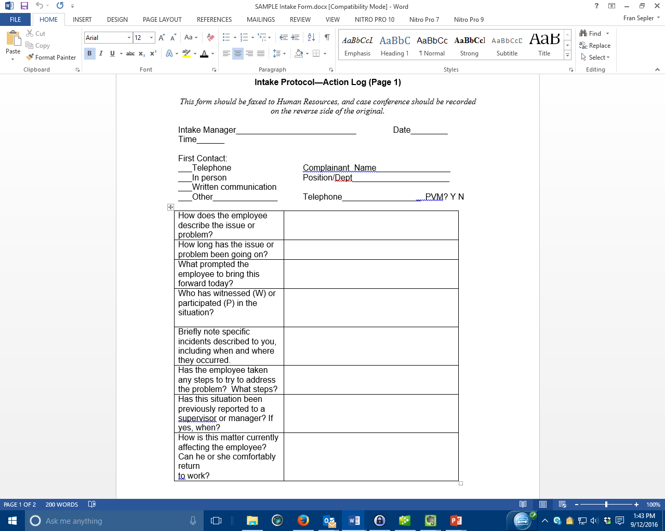

Slide 6
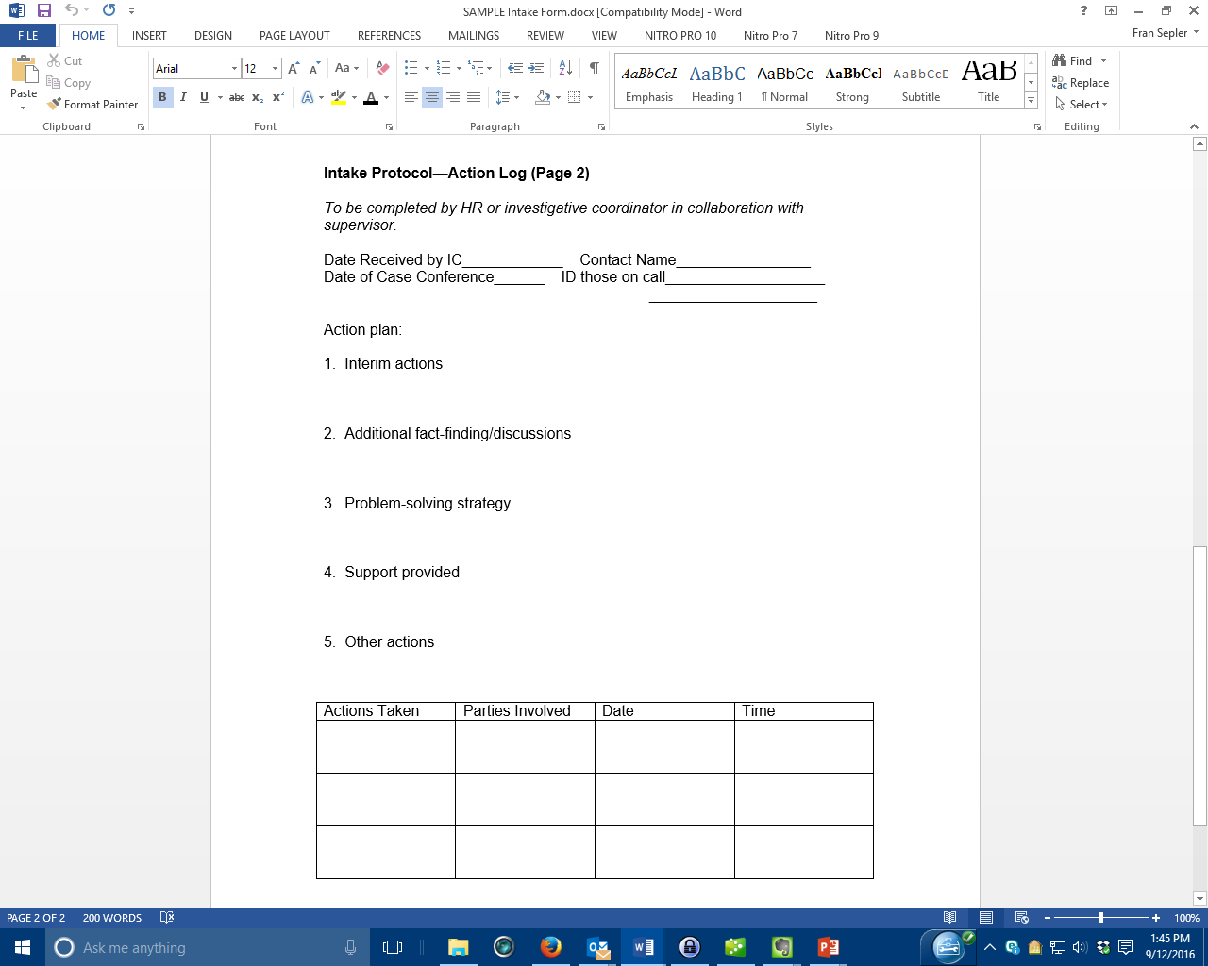

Slide 7
Using the Intake Form
Not contemporaneous
“If offered” information
Focused on the “Always’” and “Nevers”
The intake form will help you have a discussion with your HR person to determine a course of action

Slide 8
The “Alwayses”
“Thanks for bringing this to my attention.”
“We take these things seriously.”
“ We want this to be a safe and respectful work environment.”
“I’ll let you know what the next step will be.”

Slide 9
The “Nevers”
“I can’t believe (s)he would behave like that.”
“What was your part in it?”
“Why are you just bringing this up now?”
“Why do you think they did that to you?”

Slide 10
Opening Your File
Should have consistent formatting
Intentions:
  Reconstruct
  Be Comprehensive
  Consistency

Slide 11
File Contents: All Files
Cover sheet
Activity Log
Evidence Log
Notices
Correspondence
Notes
Report

Slide 12
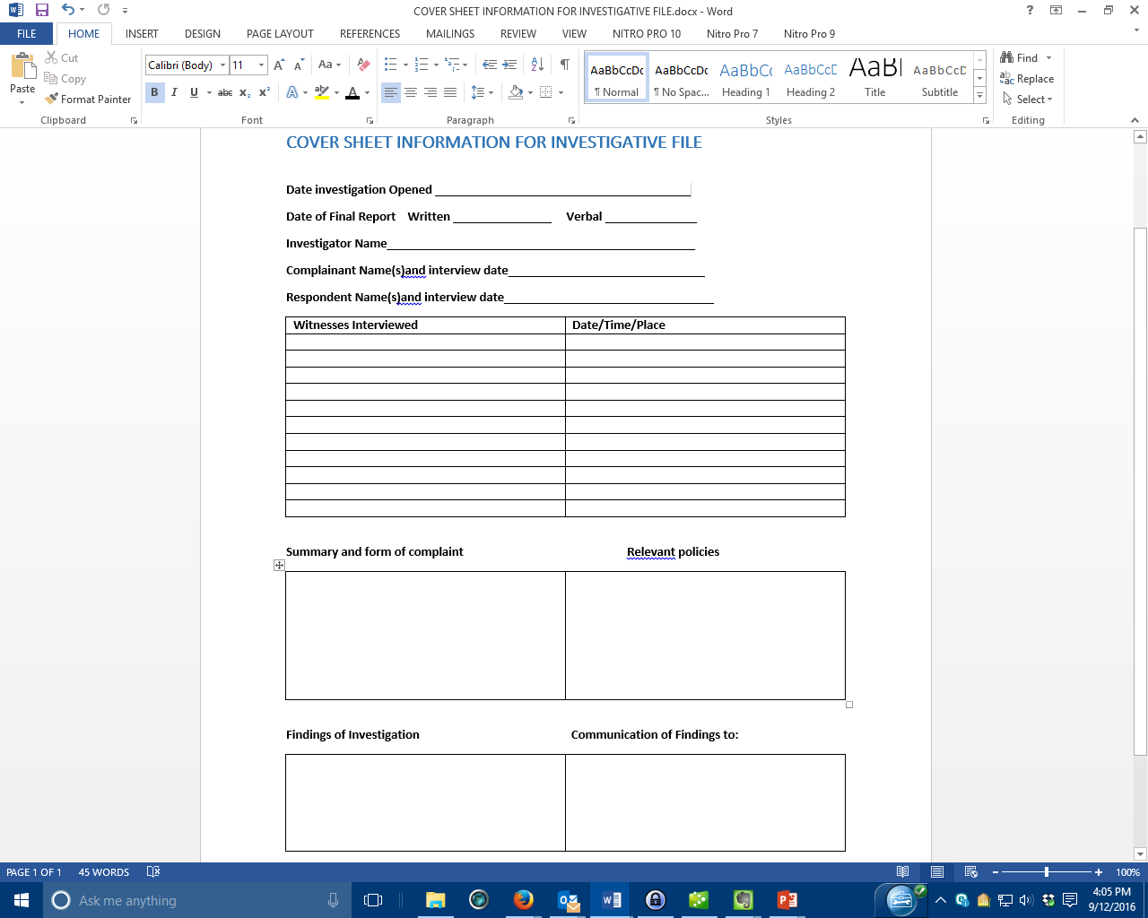

Slide 13
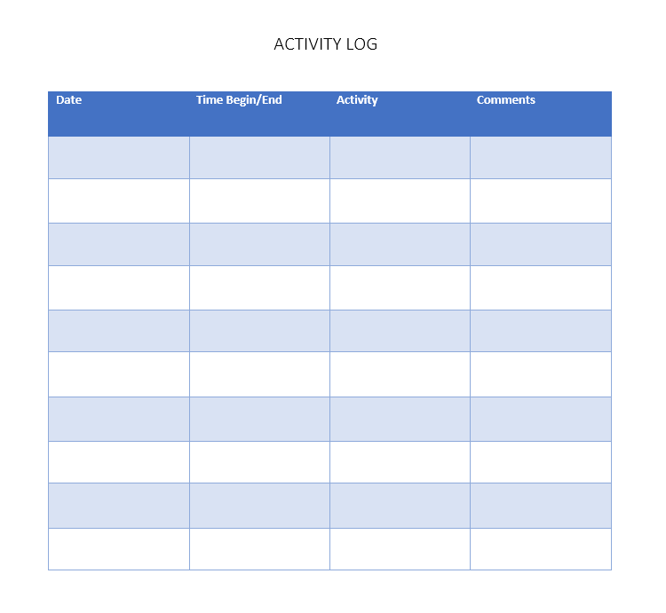

Slide 14
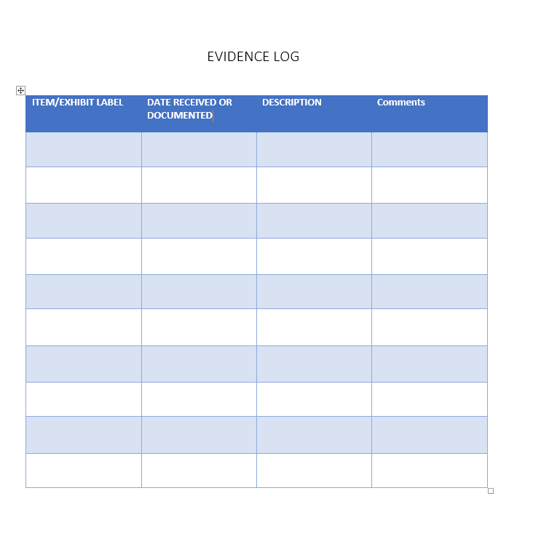

Slide 15
Interim Actions
Protect Parties
Preserve Evidence
Reduce Risk

Slide 16
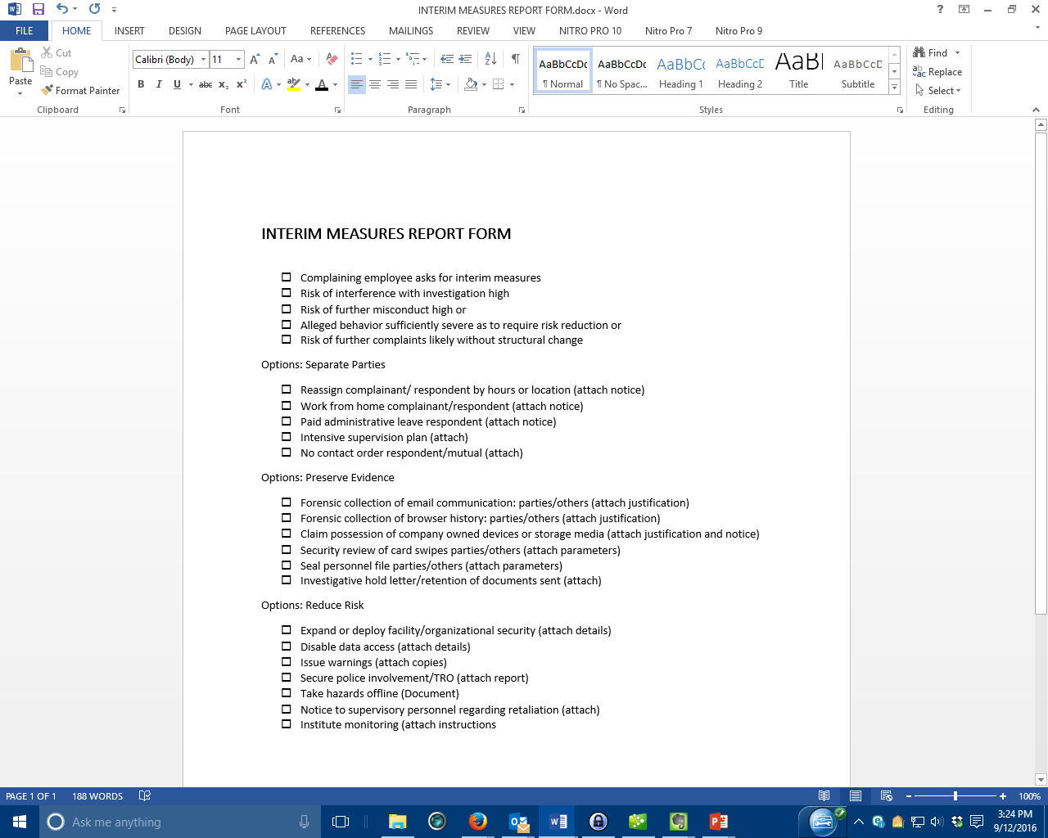

Slide 17
Investigative Hold/Preservation of Documents
For allegations involving patterns of discrimination in hiring, pay, promotion
For hostile environment allegations stretching across multiple locations/departments/decentralized units

Slide 18
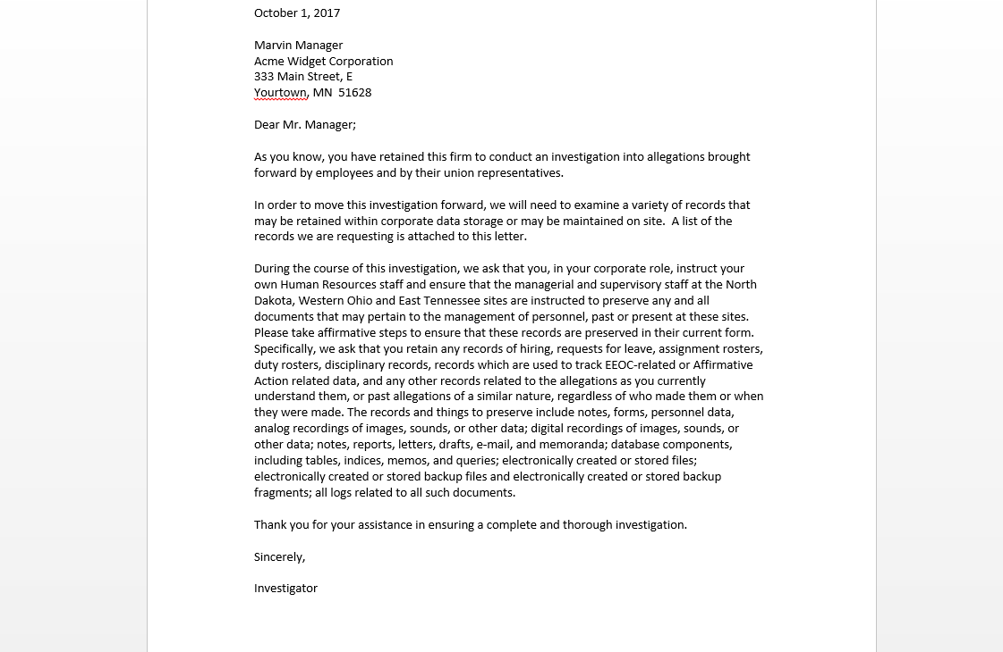

Slide 19
Decision To Investigate
Use consistent criterion to determine whether a formal/full investigation is necessary
  Is informal intervention appropriate and possible?
  Is the alleged behavior, if true, likely to result in formal action?
  Is there a duty to investigate?
  Is the matter historic or current, and if historic, is there current risk?
  Are the parties necessary to investigating available/employed/alive?

Slide 20
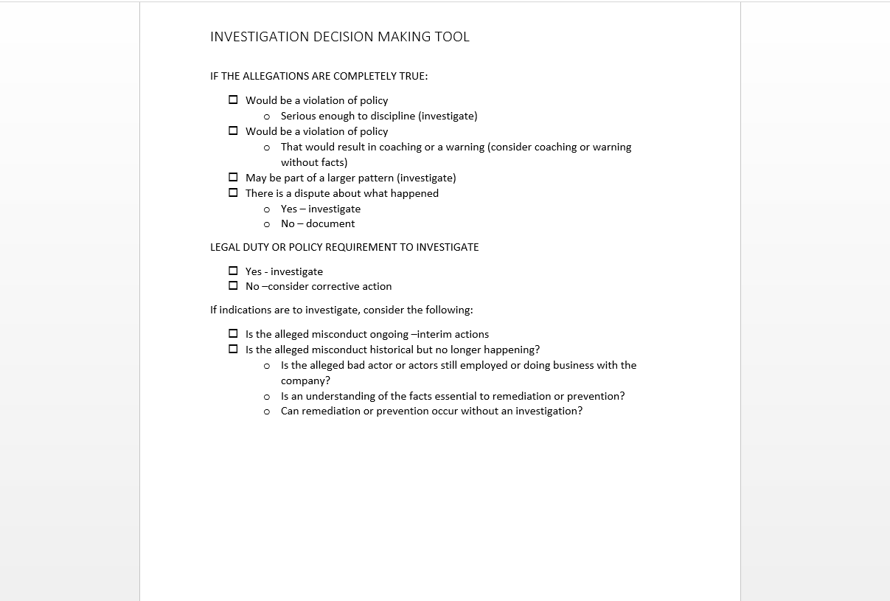

Slide 21
Who Should Investigate?
Neutrality
Independence
Expertise
Resources (time and capability)

Slide 22
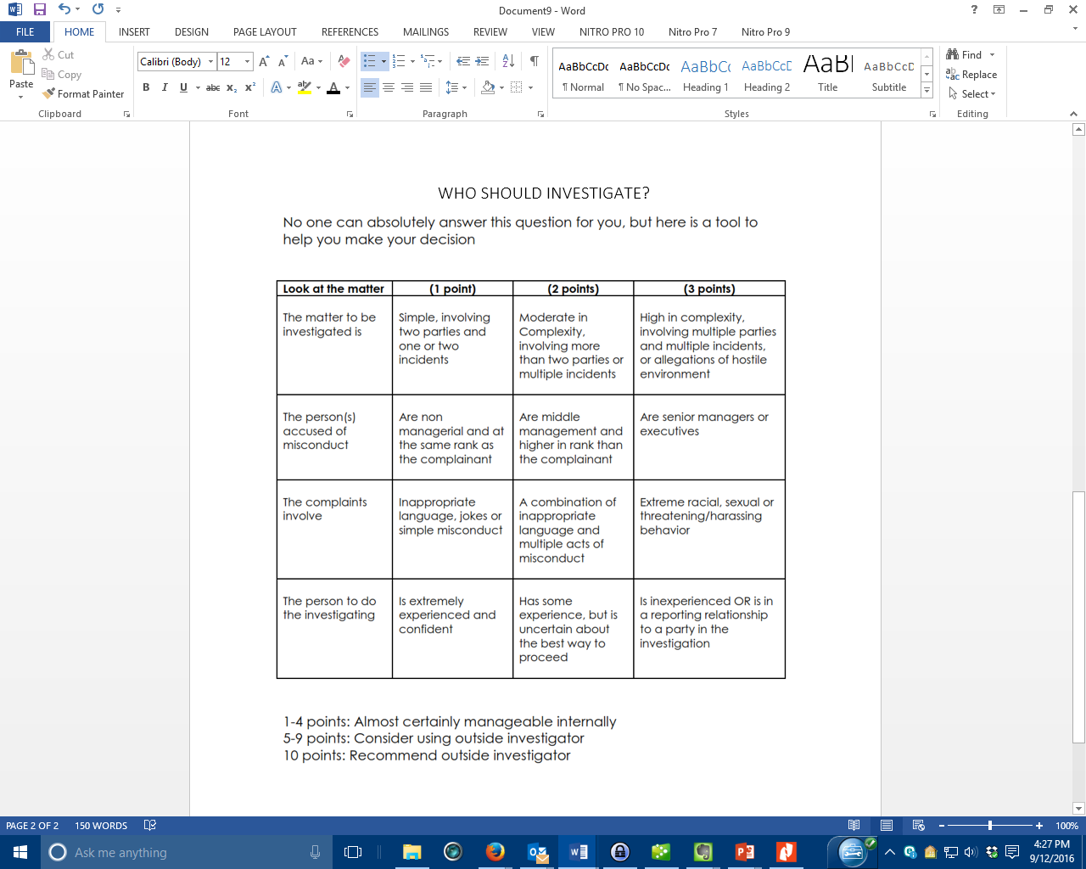

Slide 23
The Need to Know Analysis
Who needs to know:
  Details
  Parties
  Investigation is Occurring
  Nothing

Slide 24
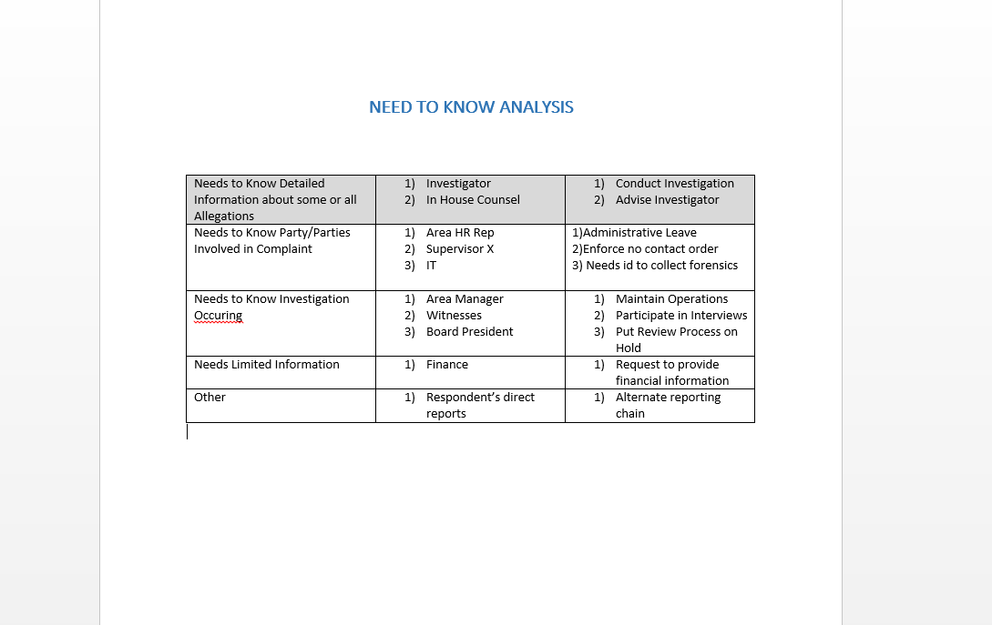

Slide 25
The Investigative Plan
Backbone to any investigation
Need not be formal, but should be a living document

Slide 26
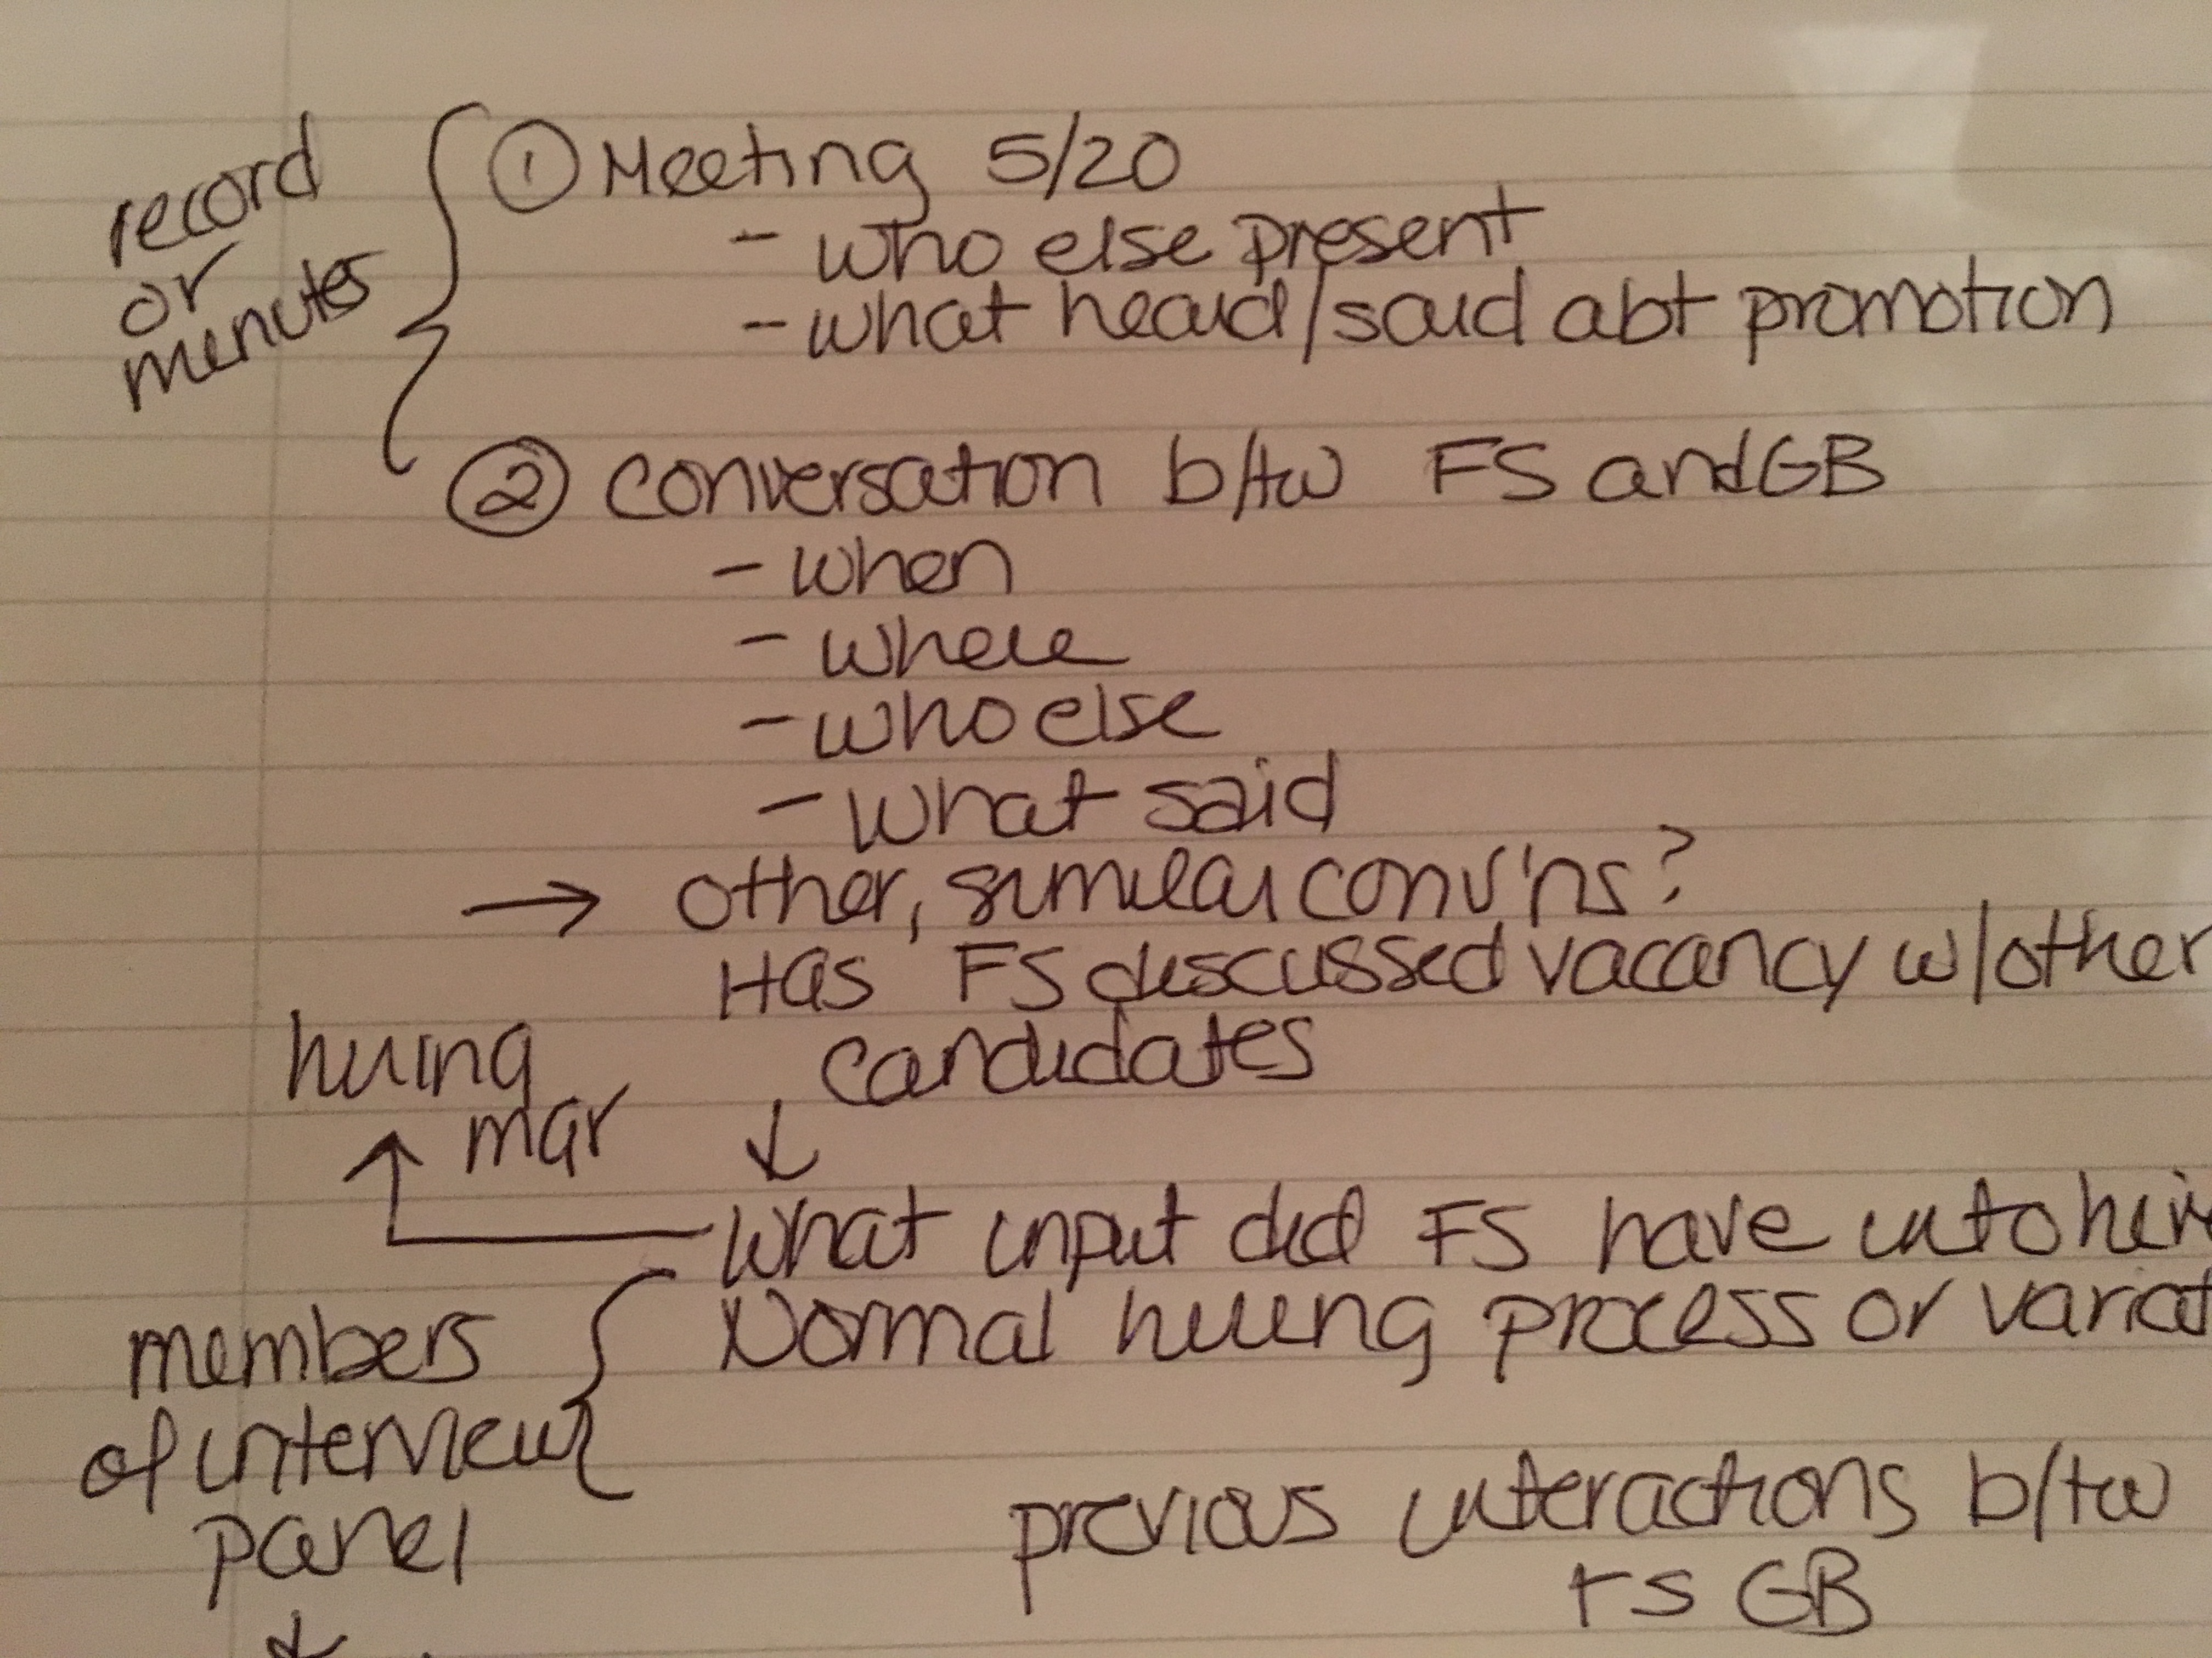
The plan can be very informal

Slide 27
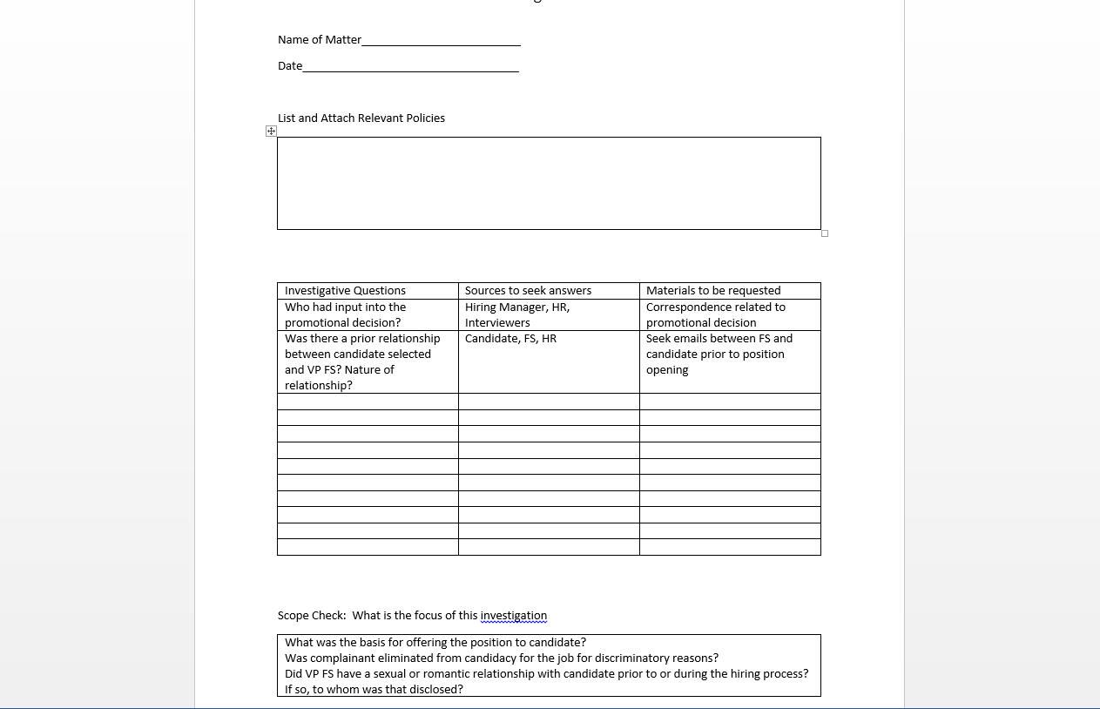
Or formal.

Slide 28
Elements of An Investigative Plan
Relevant Policies
Identification of Scope
Investigative Questions
  Which are not interview questions

Slide 29
Contacting the Employees
Consistency
Need to Know
Scripted if not you

Slide 30
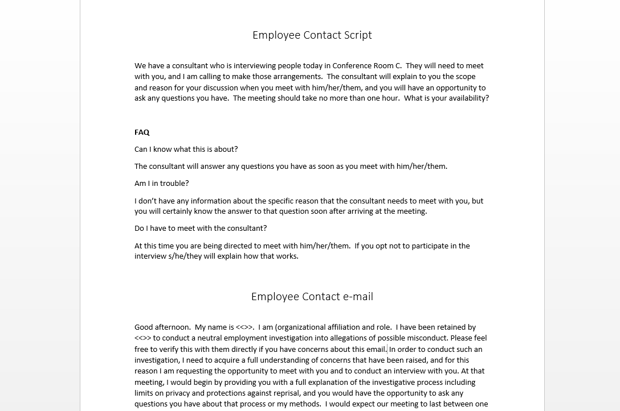

Slide 31
Notices
Provide Checklist of Notices to be Signed
Minimally to include
  Purpose of the Interview
  Basis for participation/cooperation (voluntary? Required?) and consequence of non participation
  Need to know standard and application
  Protections against reprisal and how to report
  Banner-tested confidentiality if appropriate
  Permission and expectation of follow up
  Appropriate Garrity/Tennesen/Weingarten information

Slide 32
The 5 Stages of Interviewing
Administrivia, Baselining and Connecting
  Stage setting
Uninterrupted Initial Narrative
  Listening
Reconstruction
  Analysis
Deconstruction, or “Push”
  Testing and challenging
Closing
  Recap and continuity

Slide 34
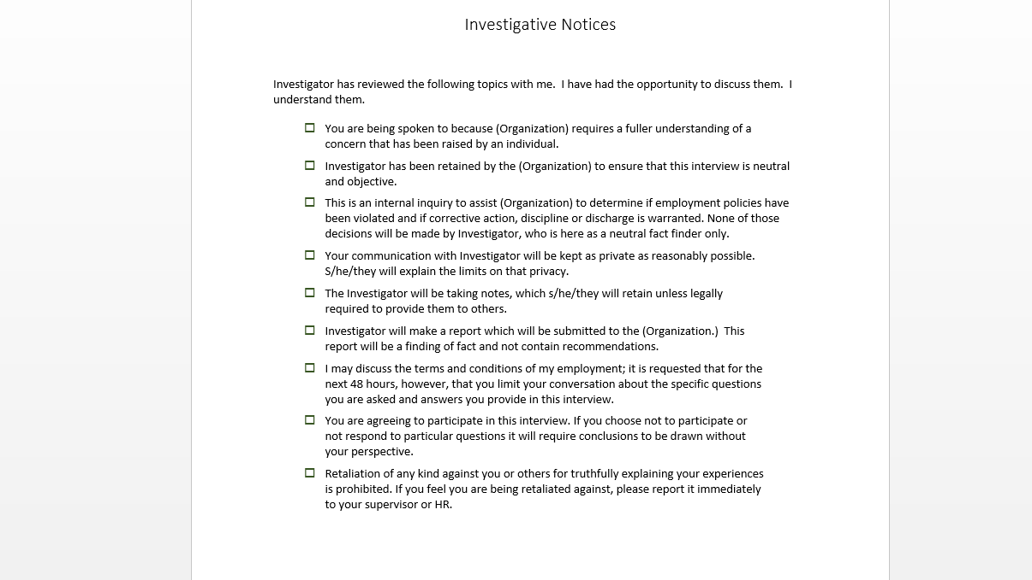

Slide 35
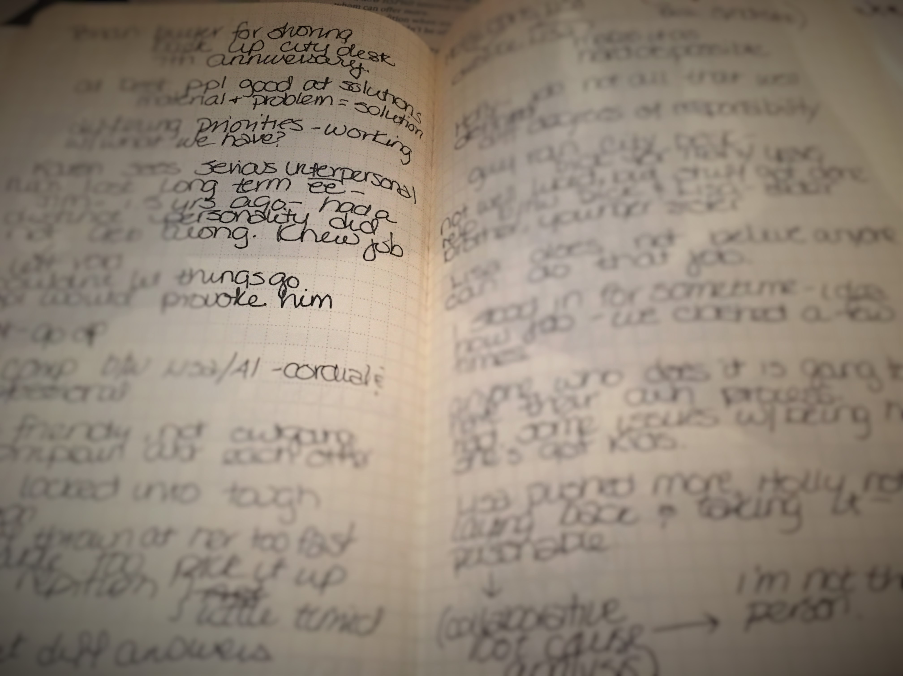
Notes don’t need to be pretty

Slide 36
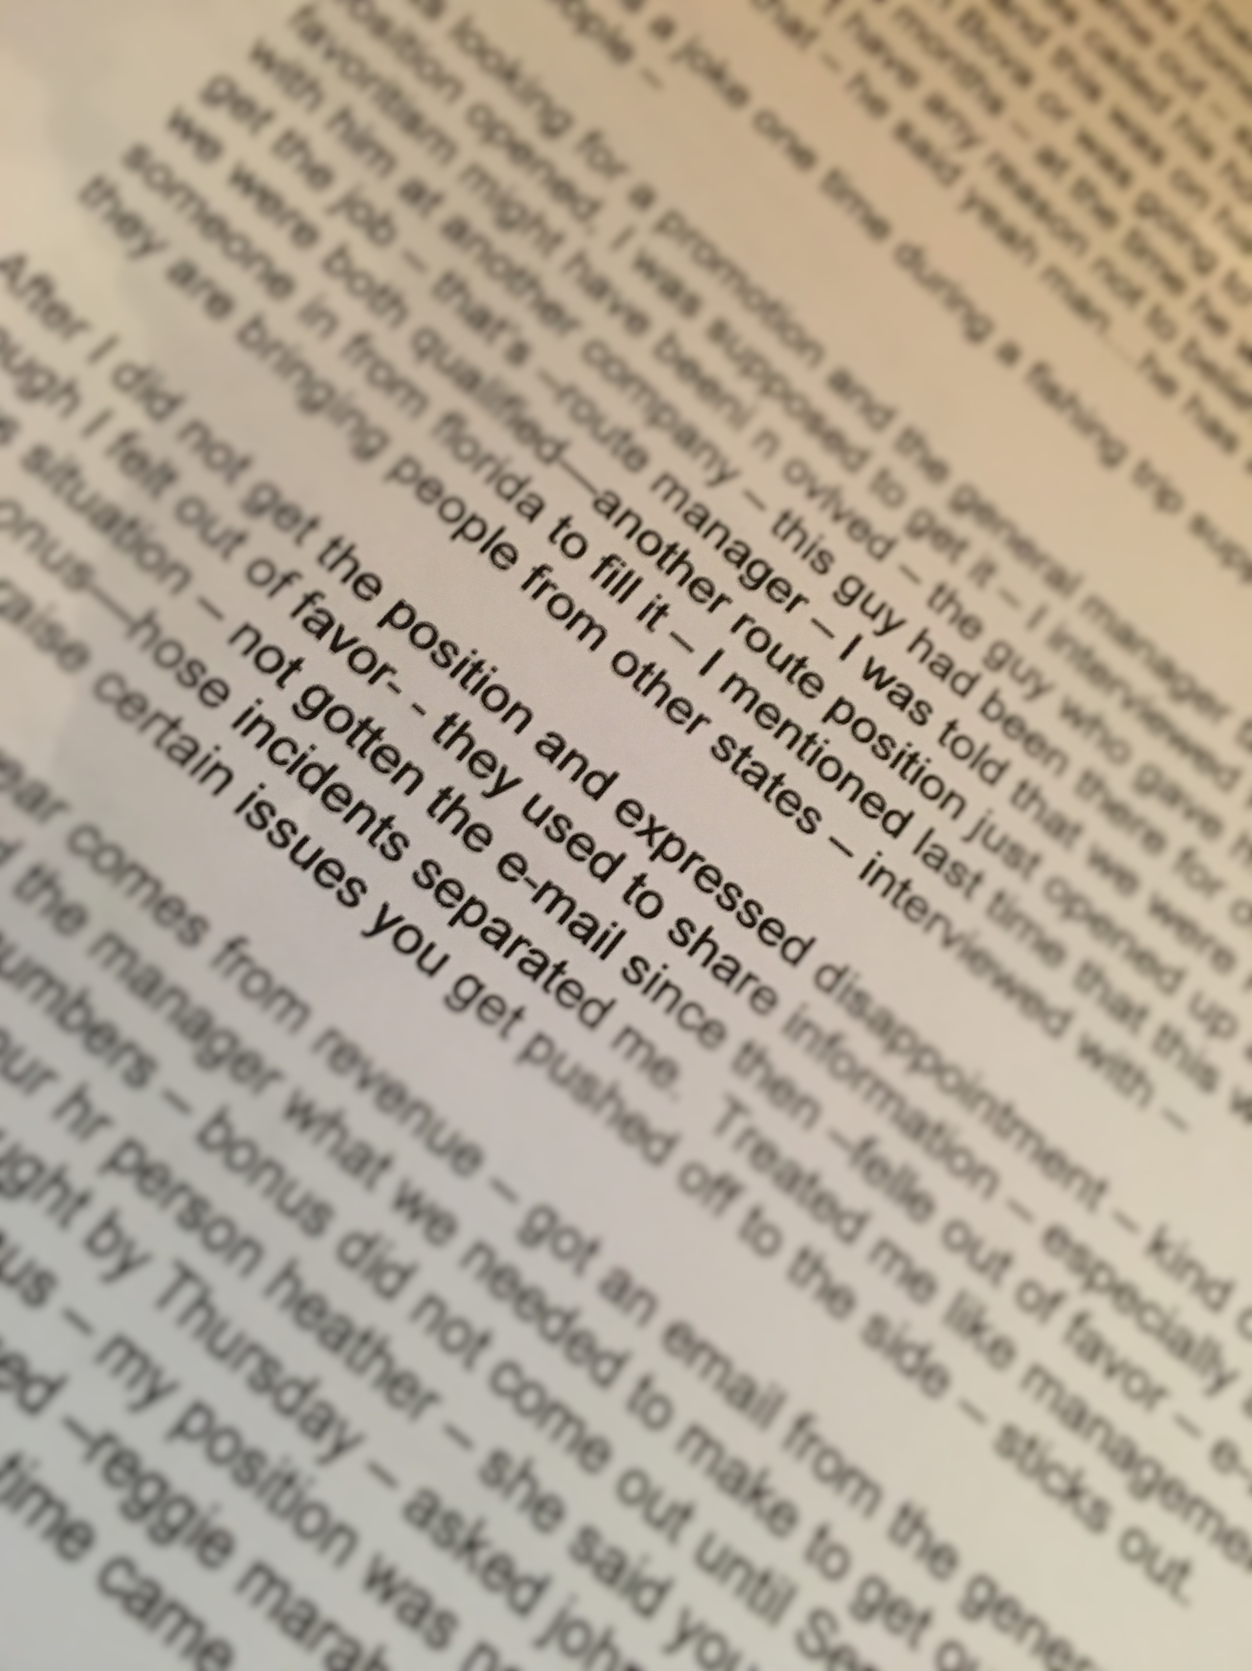
Notes don’t need to be grammatically correct

Slide 37
Notes
Must provide you with the capacity to reconstruct what was said at least two years from the date of the interview
  Raw notes should always be retained
  “Cleaned up notes” are acceptable as long as raw notes are retained
Can save original and track changes on second version or use alternate font or color

Slide 38

Credibility Notations
Must be separate and distinct from notes
Can be recorded on index cards or other discreet item
Must be in file

Slide 39

Evidence
Take photos if you can’t put it in the file
Tape a thumb drive inside the file if it is a paper file
If all stored digitally, make sure it is catalogued.

Slide 40
Evidence is Everywhere
Electronic footprints
  Cell phones
  Pagers
  Data Cards
  ATM’s
  Phone chips
  Voice Mail
  GPS devices
  Surveillance Tapes

Slide 41
More creative
Corporate discounts/id’s
Credit card receipts
Hotel and travel records
ATM cameras
Internet cookies
“deleted” emails
Vendors and suppliers

Slide 42
Notes, diaries and calendars
Obtain immediately for chain of evidence and authenticity purposes
Make copies and authenticate
Use distinctive ink

Slide 43
Generate Evidence
Take photos
Screen shots
Video or Audio records
Printouts

Slide 44
Investigative Report
May be helpful to use a worksheet
Do not retain drafts

Slide 45
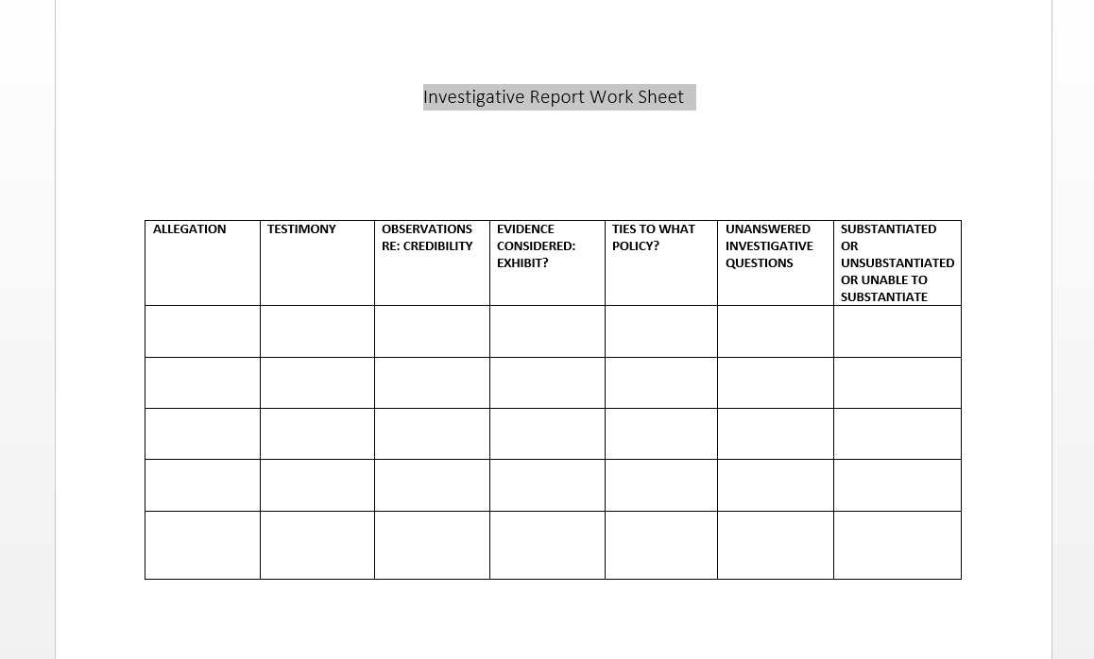

Slide 46
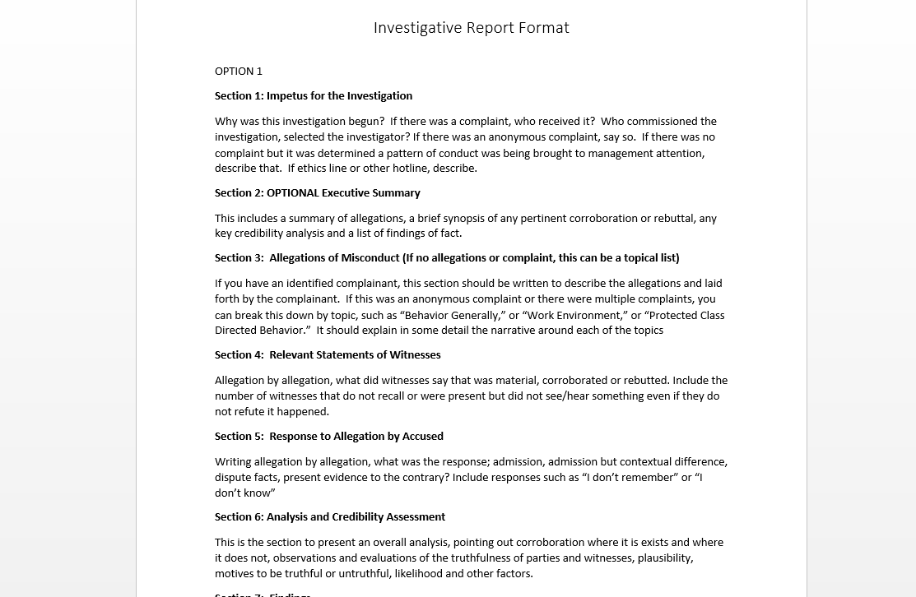

Slide 47
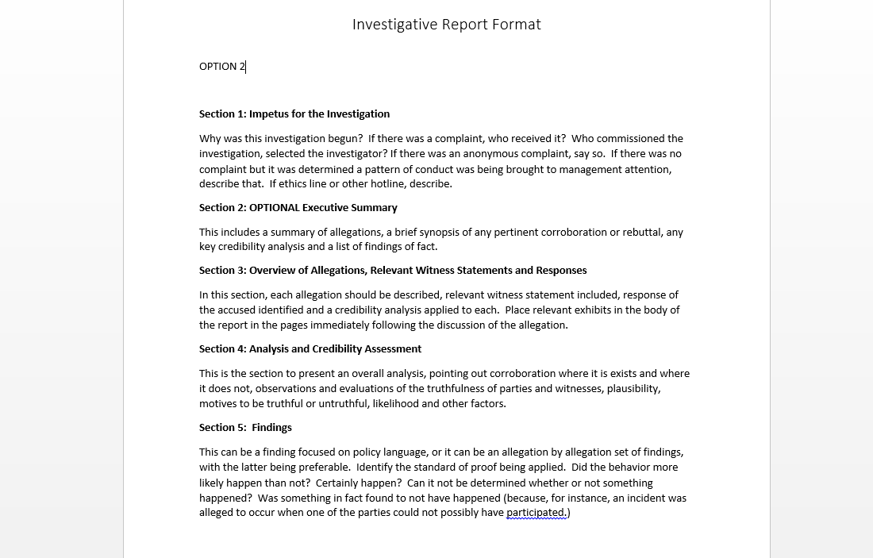

Slide 48
Findings
Statements of Fact (i.e. what happened)
Statements regarding degree of evidence to support or not support facts
Statements as to why allegations or facts asserted during the course of an investigation were not found to be supported by evidence or were false.
No legal conclusions

Slide 49
Fran Sepler, Sepler & Associates
fransepler@sepler.com

